Slide 1
ACCA
APPROVED
LEARNING
PARTNER
If you want to go fast go alone,
If you want to far go together.
~African Proverb
Enter to Learn
Live to Achieve
www.thenewsynergyspecialist.com

Slide 2
UoL Teaching Institution
Business
Consulting
Partnering with ACCA
THE NEW SYNERGY SPECIALISTS (TNSS)
STRATEGIC PARTNERSHIP PRESENTATION
ACCA
Corporate
Training
www.thenewsynergyspecialist.com
...enter to learn, live to achieve

Slide 3
INTRODUCTION
The New Synergy Specialists (TNSS) Limited is a Financial Consultancy and Corporate Training firm providing top-notch financial training and advisory to individuals, firms and organizations.
Overview
TNSS provides a fusion of vibrant, interactive and tailored learning solutions geared towards ensuring students’ examination success across all levels of the ACCA qualification and continuous development for professionals.
Business
Operations
We are a team of passionate, qualified and highly-experienced tutors operating from a world class facility; delivering an unforgettable learning experience.
Strategy
With TNSS, when students enter to learn;
they leave with a lot of achievements.
www.thenewsynergyspecialist.com
...enter to learn, live to achieve

Slide 4
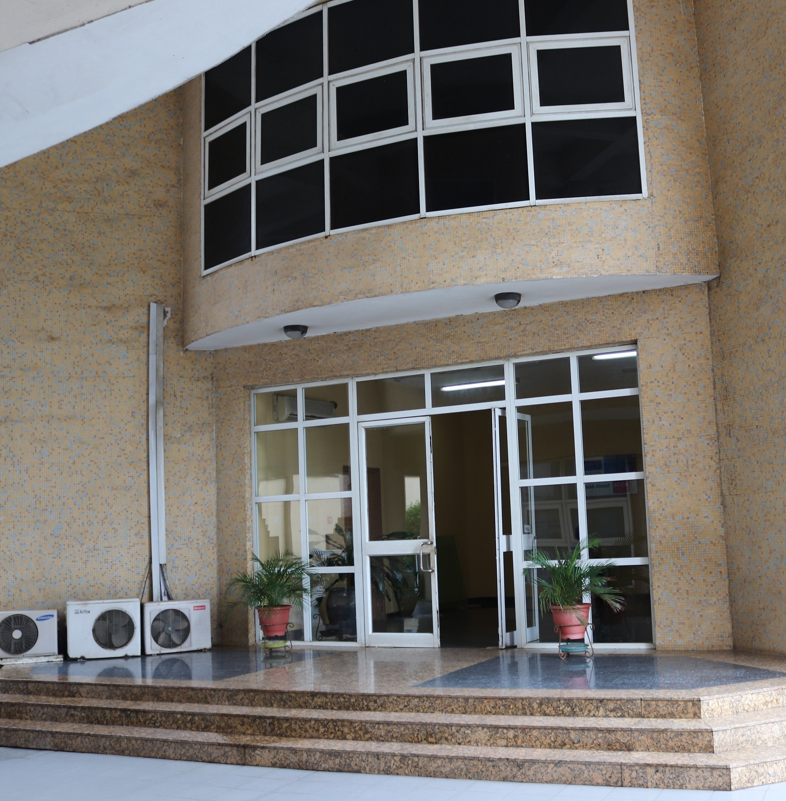
WHO WE ARE
OUR
VISION
OUR
MISSION
OUR
INSTITUTION
OUR
EXPERIENCE
To become the service provider of choice for professional and corporate learning solutions; adding value to our clients.
We provide top-notch learning and business solutions to individuals and organizations delivered through experience, passion and innovation.
Finance
Professional Refinery.
Combined total of over 80 years’ experience
www.thenewsynergyspecialist.com
...enter to learn, live to achieve

Slide 5
WHY TNSS
EXAM FOCUS
STRUCTURED TIME TABLE
PASS RATE
TUTORS AVAILABILITY
Courses @ TNSS cover the key syllabus areas that are examined and explain how they will appear in the exam and how to tackle them.
The timetable and course are flexible to cater for the tight commitment and activities of our students
We have consistently beat the Global Pass Rate in over 75% of papers of our registered students from our initial examination diet session in September 2015.
TNSS employs a team of devoted and dedicated tutors able to answer any questions you may have, within 24 hours on working days..
PAPERS OFFERED
CONSISTENCY OF APPROACH
INFRASTRUCTURE
We are the only tuition center that prepare students for all 16 ACCA Papers and Diploma in International Financial Reporting (DipIFR)
Our approach to tutor training, material preparation and course presentation means that you will get a consistent "message" regardless of the mixture of course types chosen or center you attend.
Excellent Infrastructural facilities.
www.thenewsynergyspecialist.com
...enter to learn, live to achieve

Slide 6
THE NEW SYNERGY SPECIALIST
1
Our Beginning
2
Our Kick Off Point
Re-established as TNSS in August 2015
New focus of commitment and Passion
Creating World-class with local resource because Nigerian students deserve the best
Offered 4 weeks free tutoring & Question Based Revision sessions
September 2015 diet partnering with ACCA
Started in 2002 as the first ever ACCA tuition house in Nigeria
Originally called SWOT Associates
Founded Synergy Professional in 2006
Increased growth resulting in loss of focus
Ivy league exodus in 2013
3
Our Substainability Track
3
Our Achievements
ACCA Gold Approved Learning Partner by 2016
On course with achieving Platinum status as ACCA Platinum Approved Learning Partner by third year anniversary
Commencing Continuous Professional Development (CPD)
70% pass rate for all diet papers
Full fledged tutoring in September 2015
Approved ACCA Learning partner by December 2015
Student Prize winners - 2nd Best Global, Best in Africa
Lecturer base of over 40 persons across all subjects
www.thenewsynergyspecialist.com
...enter to learn, live to achieve

Slide 7
INVESTMENT SO FAR
From August 2015 to October 2018, TNSS has invested about N230 Million (almost £500,000) in the delivery of world class ACCA tuition and promotional activities as shown in the table below
Details | NGN | GPB
Facility Use | 45,000,000.00 | 100,000.00
Facilitators’ Fees | 40,500,000.00 | 93,114.75
Other Administration Fees | 42,898,937.50 | 107,865.37
Events – Tertiary Institutions | 1,400,000.00 | 3,278.69
Total Assets | 31,059,440.00 | 69,047.34
Miscellaneous | 14,000,000.00 | 32,786.89
www.thenewsynergyspecialist.com
...enter to learn, live to achieve

Slide 8
OUR PROGRAMMES
ACCA Tuition
TNSS offers weekday & week-end tuition programme, which are flexible and structured to enable our students, meet the demands of their work, study and other commitments.
University of London
We serve as a teaching and mentorship center for the university of London, students who are interested in having the MSc in Professional Accountancy will be tutored and supported at TNSS
ACCA
Oxford Brookes
We provide Oxford Brookes project mentorship for our students who will like to take advantage of a BSc in Applied Accounting from Oxford Brookes University, This service is free of charge for ALL our students.
CPD Trainings
We have introduced a new program for members of the association towards meeting their Continuous Professional Development requirements
www.thenewsynergyspecialist.com
...enter to learn, live to achieve

Slide 9
OUR PARTNERSHIP
Corporate Partnerships
Tertiary Institutions Partnerships
Foreign Institution Partnership
Price Waterhouse Coopers
Ernst & YoungKPMG
Deloitte
Lagos state Government
Ojike & Partners
Dafinone
Mazars & Co
Sanofi Aventis
Sage
Fate Foundation
Babcock University
Elizade University
Covenant University
Caleb University
University of London
Charted Quest Institute South Africa
www.thenewsynergyspecialist.com
...enter to learn, live to achieve

Slide 10
UNIVERSITY OF LONDON PARTNERSHIP
Marketing Plans
We plan to maximize this partnership by working closely with the ACCA Nigeria, our foremost goal is to have a good number of student enrolled and prepared to take up the qualification. It will enrich our brand reputation to have students tutored by TNSS at the next graduation ceremony, we will require the full support of ACCA in the following area;
Data driven mail | We will require ACCA support to help push out strategic email communications to all her students, affiliates members and employers with this we can enter into strategic partnerships
TNSS Alumni | We will launch the TNSS Alumni platform to enable us connect will all past students of the institution, and share newsletters with them on the benefit of the UoL qualification
Web Paid Campaigns | We will generate video to showcase TNSS, the content will be shared on our web page, and social media and other identified platforms, we will require the financial support of ACCA to promote this on strategic platforms such as goggle
Engagements activities | We also need funds to enable us organize seminars ,symposium, and events geared towards attracting students
www.thenewsynergyspecialist.com
...enter to learn, live to achieve

Slide 11
A
SKANS PARTNERSHIP
www.thenewsynergyspecialist.com
...enter to learn, live to achieve

Slide 12
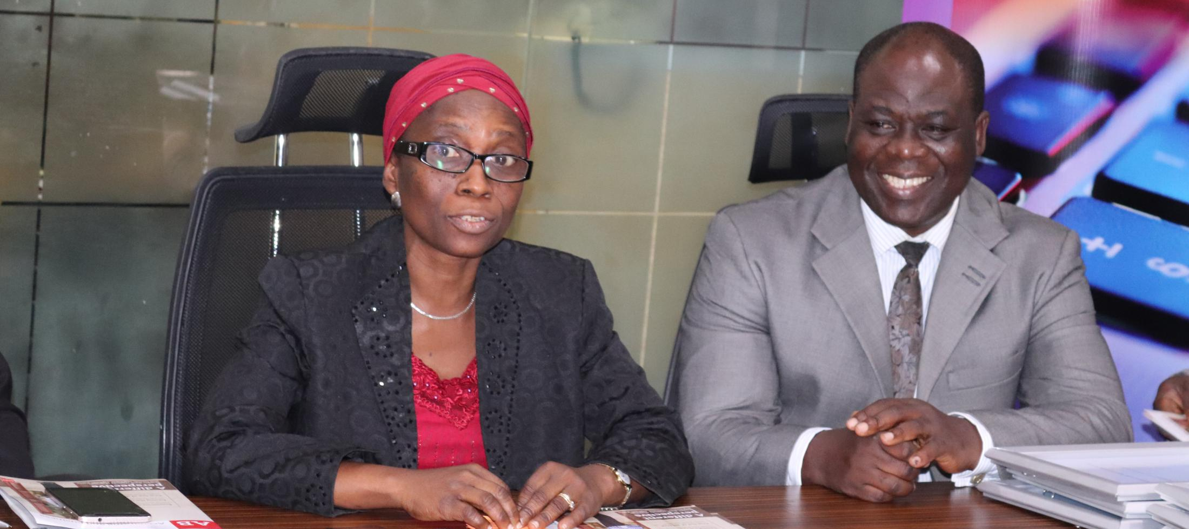
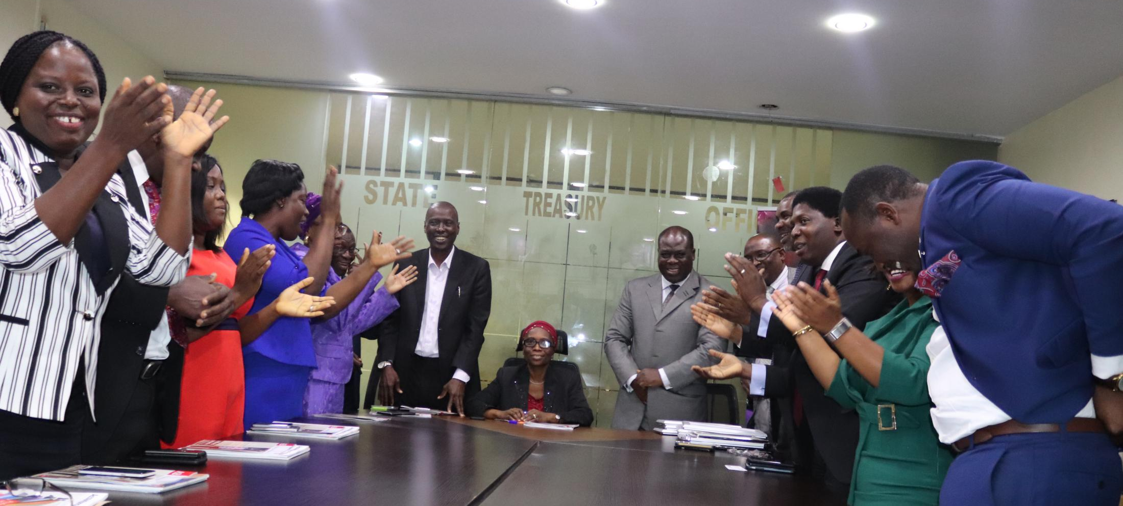
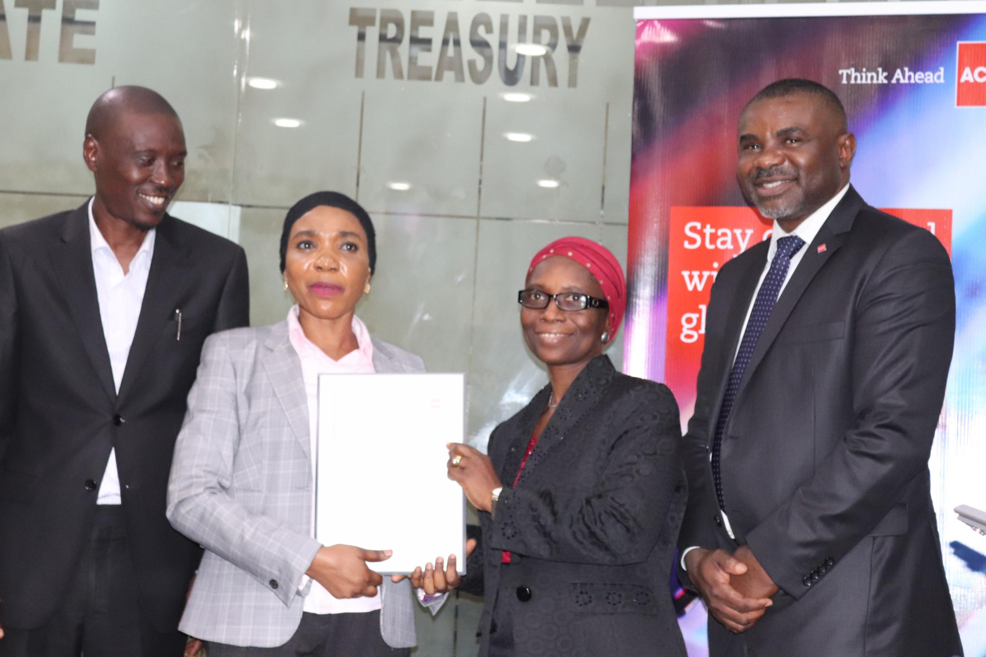
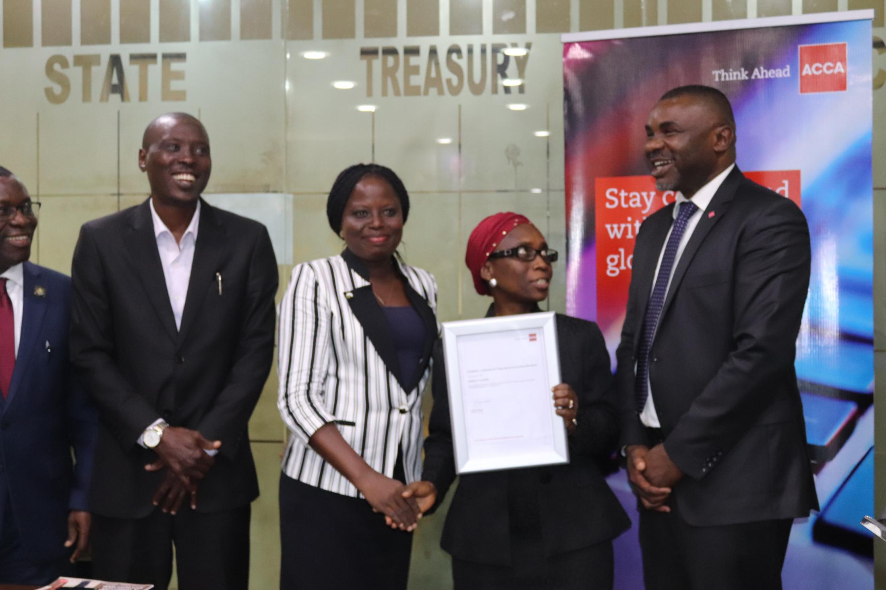
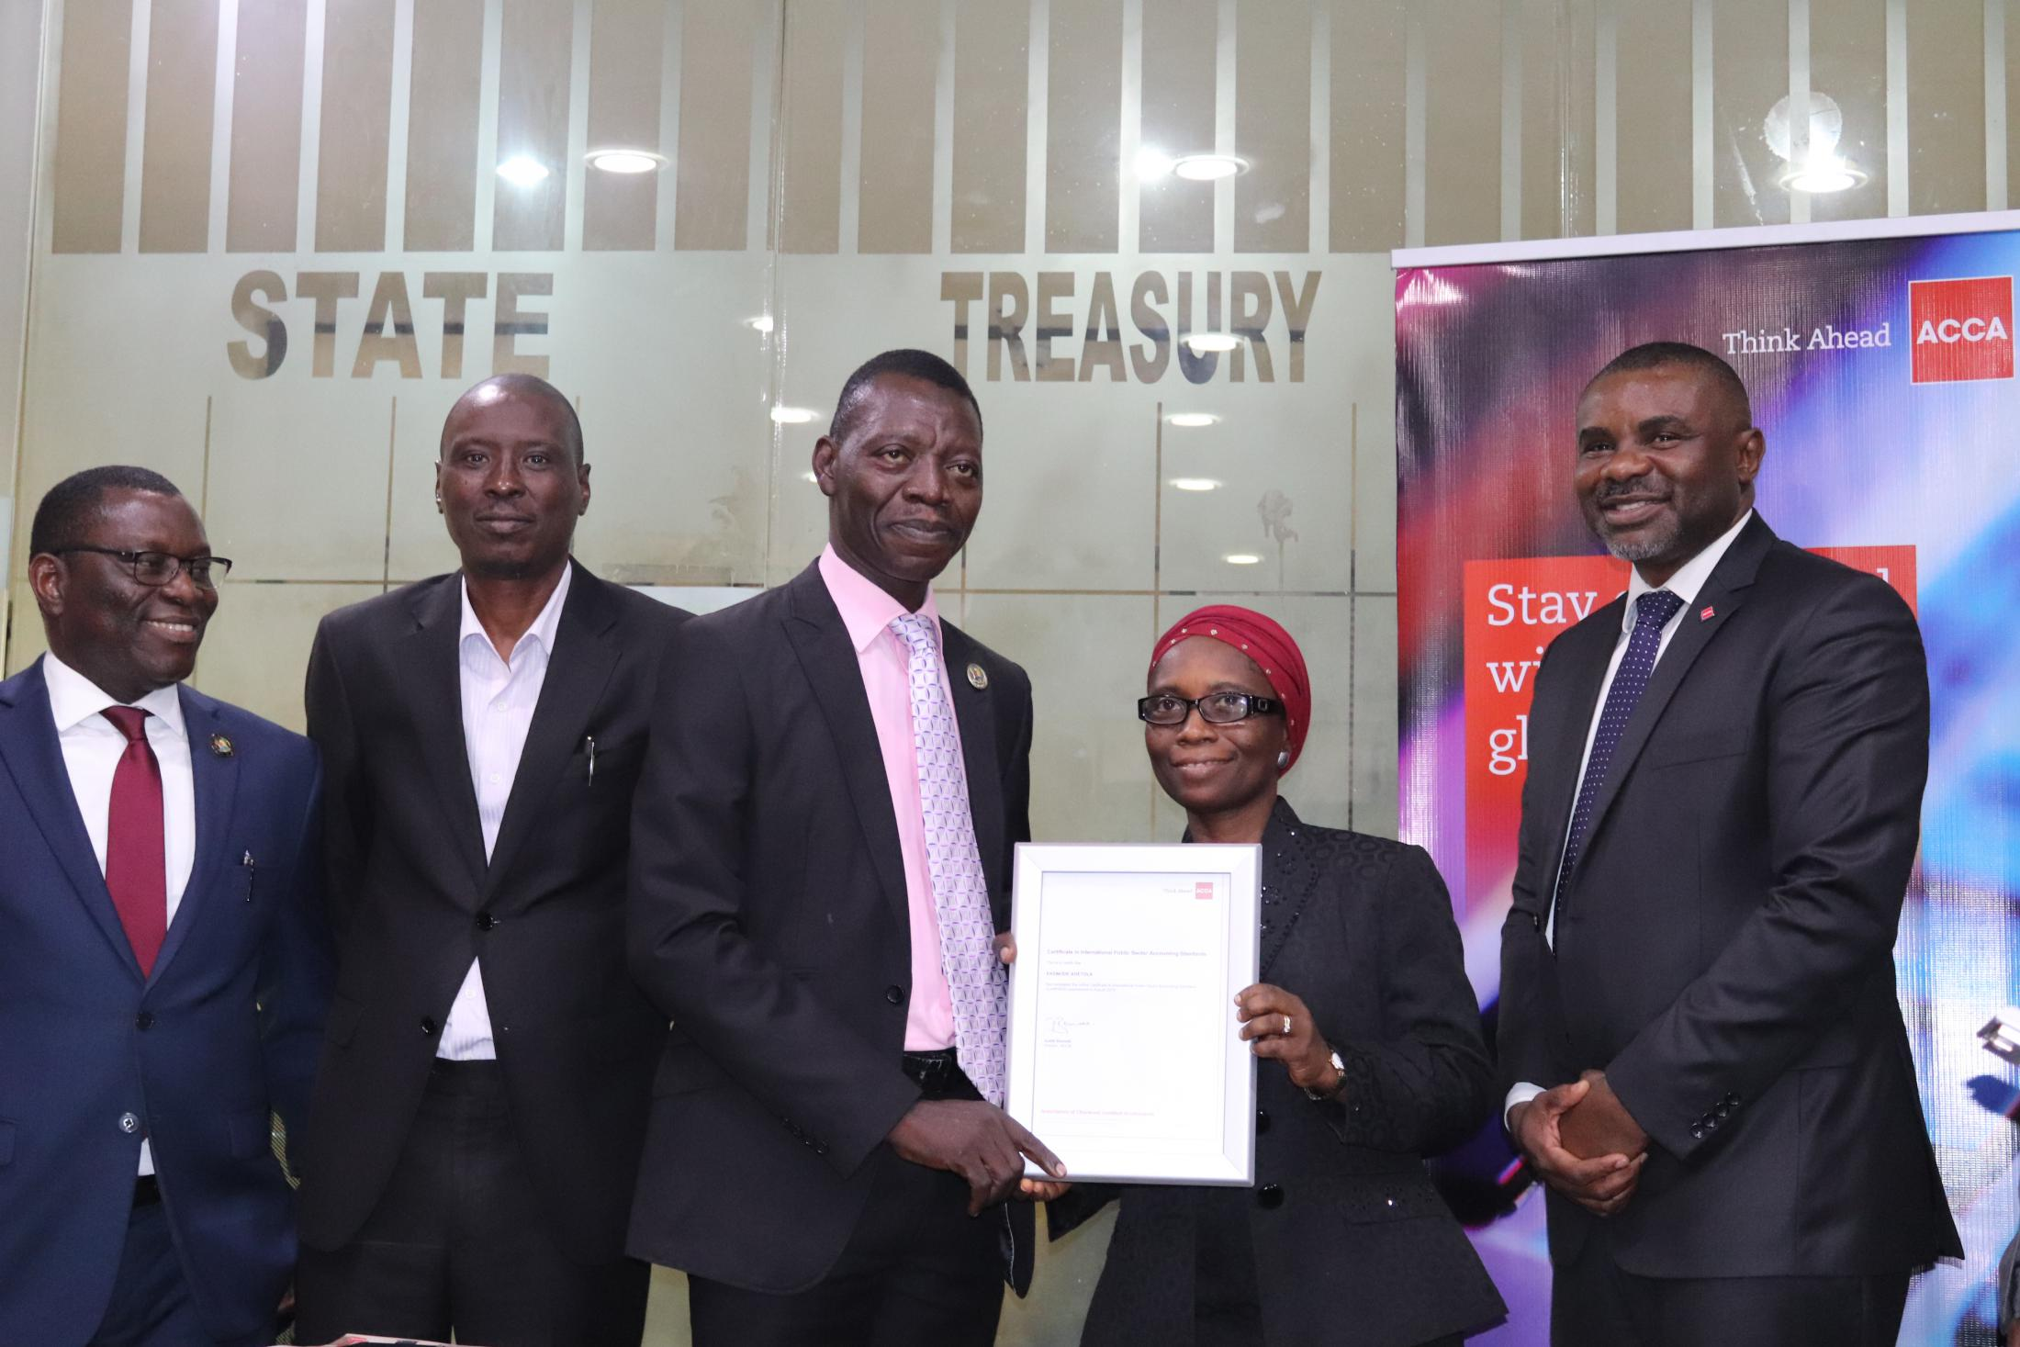
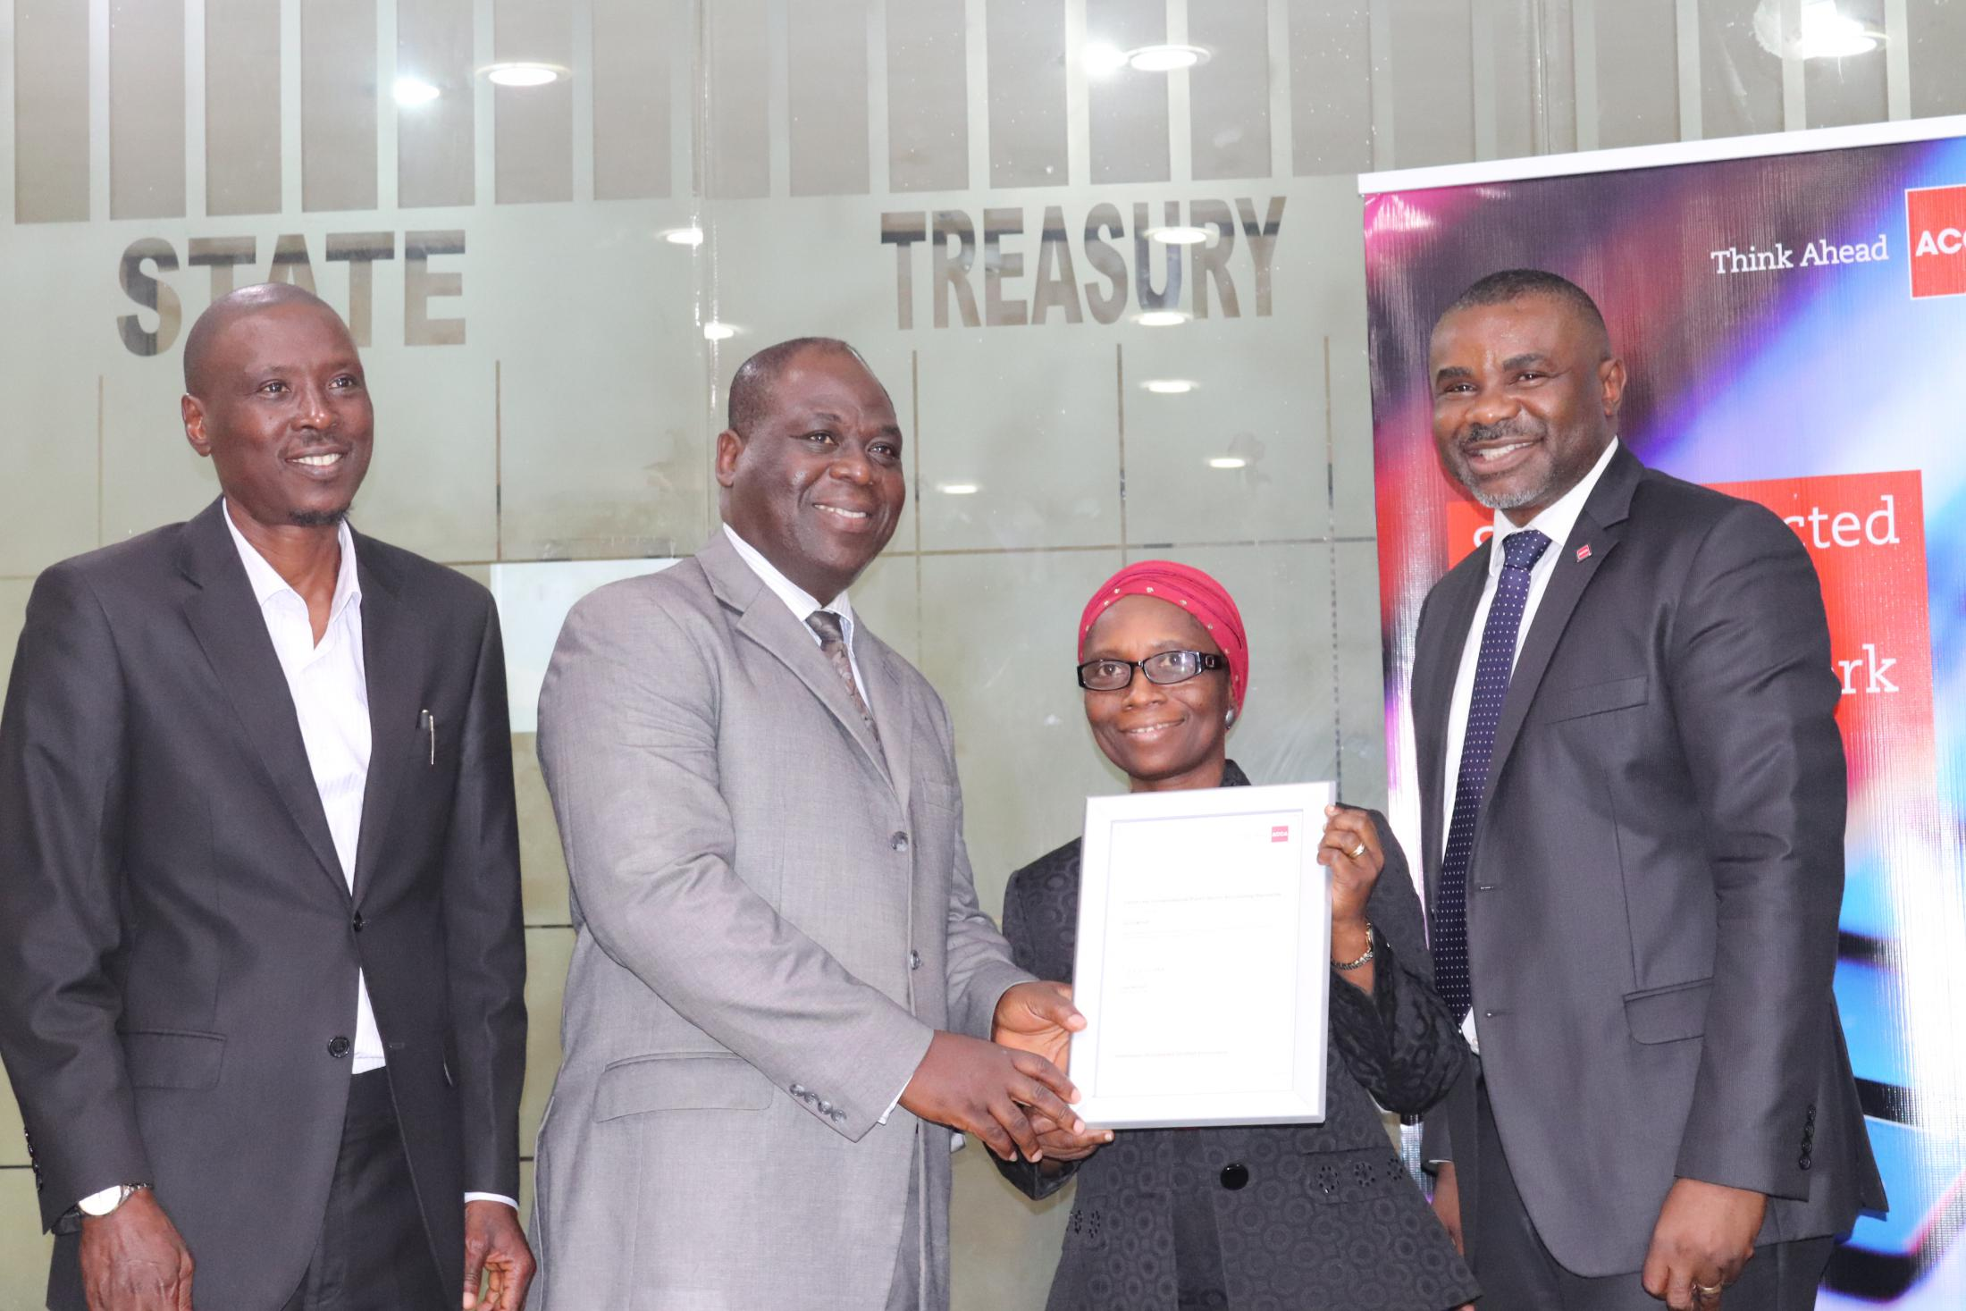
PARTNERSHIP WITH LAGOS STATE
GOVERNMENT ON IPSAS QUALIFICATION
www.thenewsynergyspecialist.com
...enter to learn, live to achieve

Slide 13
OUR SUCCESS CHART
www.thenewsynergyspecialist.com
...enter to learn, live to achieve

Slide 14
OUR TESTIMONIAL
Roselyn Efemelu
Onome Akpomudia
Busola Sogbolu
Top ACCA Affiliate in Nigeria December 2017/2018
www.thenewsynergyspecialist.com
...enter to learn, live to achieve

Slide 15
STRATEGIC BUSINESS LEADER
What worked for Nigerian Students
With the introduction of the SBL paper, we realigned our Faculty towards providing the right tutoring for the paper, with 6 dedicated lecturers. We also adopted a different teaching approach to help our students better prepare for the exam.
The tutoring style includes – Role plays, student presentation, Group assessment centre discussions and News review sessions towards understanding case study scenarios. As seen from the result below our this style of teaching worked.
Being a new exam we were quite impressed with our students overall performance.,
8 students entered for the SBR exams and 4 passed giving 50% pass rate against global 45%
4 students entered for the SBL exams and 3 passed giving 75% pass rate against global 47%
www.thenewsynergyspecialist.com
...enter to learn, live to achieve

Slide 16
STRATEGIC BUSINESS LEADER
Learning from last Diet
In order for our teaching strategies to be truly be effective , we will need students to truly embrace it,
We will intensify our approach towards a more engaging tutoring style as we look forward to recording a 100% pass rate in December diet exam.
Our classes will start by focusing more on time management and how to answer case study questions.
We will adopt a blended learning approach to better prepare our students for December diet exam, with this we hope to record 100% pass rate.
www.thenewsynergyspecialist.com
...enter to learn, live to achieve

Slide 17
STRATEGIC BUSINESS LEADER
Our experience & expectations
As a flow from the success experience last diet our expectation is that ACCA will assist us in marketing, which will invariable position us for visibility. We would appreciate the following support;
Newsletter/Emails/Messaging
Print/Publications strategy
Employers communication
Blog/Ad campaign
www.thenewsynergyspecialist.com
...enter to learn, live to achieve

Slide 18
UNIVERSITY OF LONDON PARTNERSHIP
Enrolment/Admission
support
Flexible learning
options
Student advise
center
TNSS has been approved as the exclusive teaching institution for the MSc in professional Accountancy from University of London. We now have the responsibility of providing tuition support to ACCA students in Nigeria who are interested in earning this internationally recognized degree, by providing;
Face to face study
Online study
Blended learning
www.thenewsynergyspecialist.com
...enter to learn, live to achieve

Slide 19
FUTURE OPPURTUNITIES
Students
Increase number of student ACCA across Nigeria
Increase number collaborations and partnerships across Nigeria
Increase examination pass rate for all papers
Members
Signpost skilled ACCA members to cover the increasing human capital gaps across the global economy.
Organize outdoor training for corporate organizations on new IFRS exposures and new developments in the industry
Organize quarterly employability and professional networking seminars
Trainings
To be one-stop-shop for capacity building
Build an end-to-end School
Facilitate Internship placement for students
Organize training activities
www.thenewsynergyspecialist.com
...enter to learn, live to achieve

Slide 20
FUTURE OPPURTUNITIES
Examiners
Limited access to course examiner for an interactive sessions on best practices and guidance on examination requirements
Difficulty in collaborating with ACCA material managers locally
Funding
Limited number of computers in our CBE room to carry out CBT mock exams
Lack of funds to pay for some partnership franchise which would facilitate expansion and brand reputation
Limited resources to oraganise engagement activities geared towards students recruitment
Shortage of funds to promote marketing activities
Expansion
Low level of global support towards local collaborations with tertiary institutions
Difficulty in collaborating with ACCA material managers locally
www.thenewsynergyspecialist.com
...enter to learn, live to achieve

Slide 21
OUR STRATEGY - 2018
Facilitate entering into more agreements with tertiary institutions
Strengthen relationships with the Big Fours
Build more local and foreign collaborations/partnerships with tertiary institution, employers and government bodies
Use data driven marketing to promote recruitment and UoL qualification with support from ACCA
Engage with admission agencies to signpost students interested in foreign qualifications
www.thenewsynergyspecialist.com
...enter to learn, live to achieve

Slide 22
CBE CENTRE COSTING
We are looking at creating a 100 seater CBE Center at an estimated cost of N43million – GBP 106,000
Details | CBE Cost Current - NGN | CBE Cost Current - GBP | CBE Cost Future - NGN | CBE Cost Future - GBP
Furniture | 175,000 | 438 | 7,000,000 | 17,500
Network Systems | 244,500 | 611 | 5,000,000 | 12,500
Desktop Systems | 275,000 | 688 | 20,000,000 | 50,000
Server | 520,000 | 1,300 | 10,000,000 | 25,000
CBE Center Fees | 600,000 | 1,500 | 600,000 | 1,500
www.thenewsynergyspecialist.com
...enter to learn, live to achieve

Slide 23
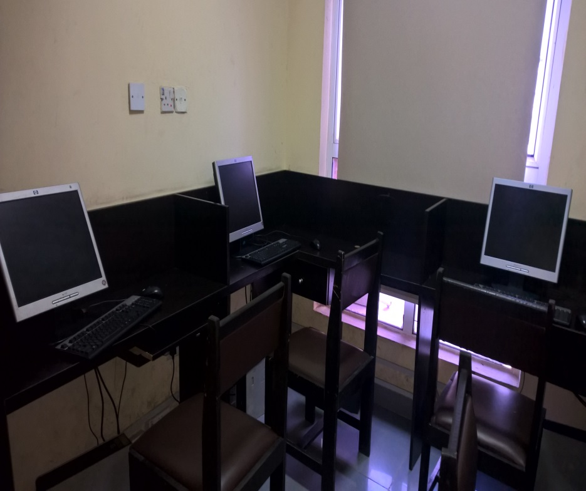
CBE CENTRE COSTING
Current CBE Center
Proposed CBE Center
www.thenewsynergyspecialist.com
...enter to learn, live to achieve

Slide 24
Thank You
Question and Answers

